Slide 1
Ballistic Velocity Variance
Prepared for Rabbit Creek Shooting Club
Submitted by DRT Consulting LLC
Request Date: March 1, 2023
Submittal Date: May 2, 2023

Slide 2
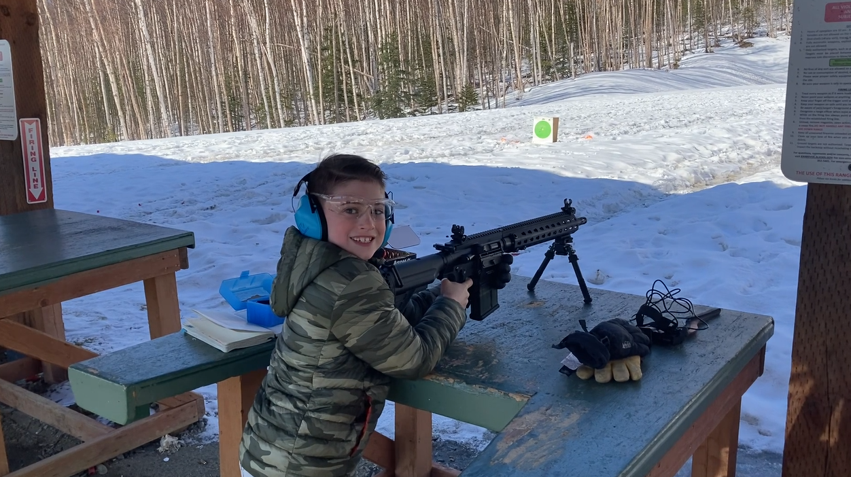
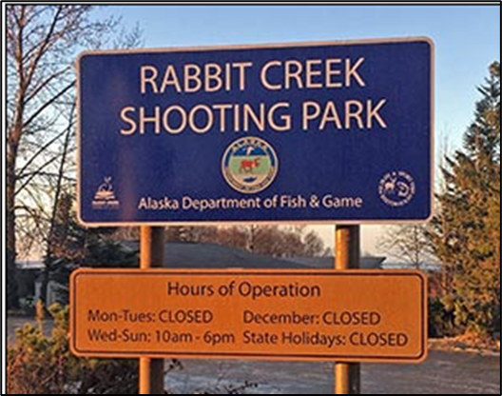
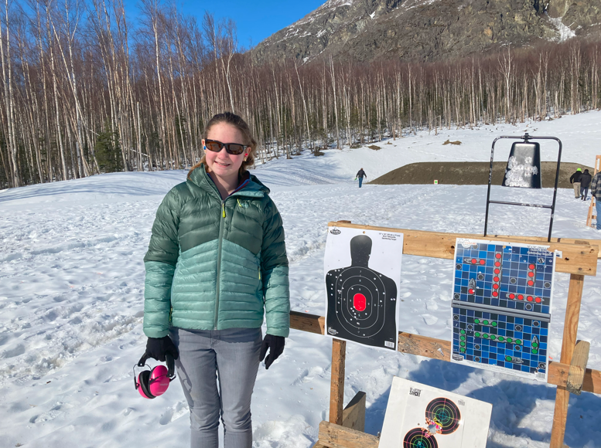
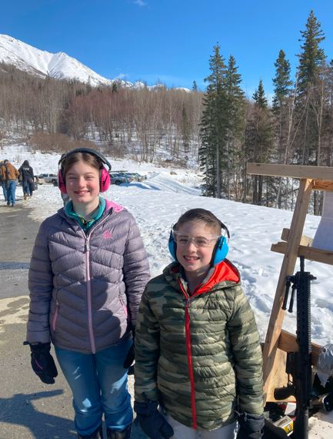
Thank you, Rabbit Creek Shooting Club!

Slide 3
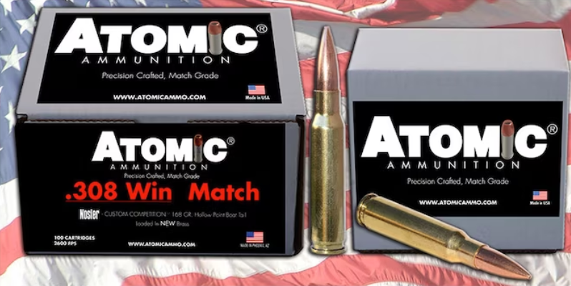
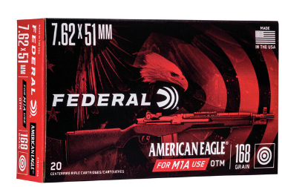
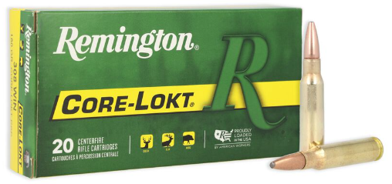
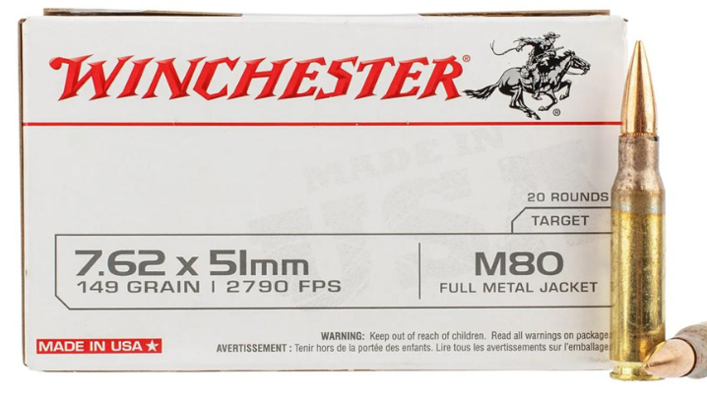
The Goal Explained
Rabbit Creek Shooting Club is hosting a 500 yard rifle competition.
Each competitor will use the same make and model rifle provided by the club.
Each competitor will use the same ammunition provided by the club.
The club will choose one of 4 different ammunitions to supply to each shooter.
Request: “Which ammunition has the smallest variance in velocity?”

Slide 4
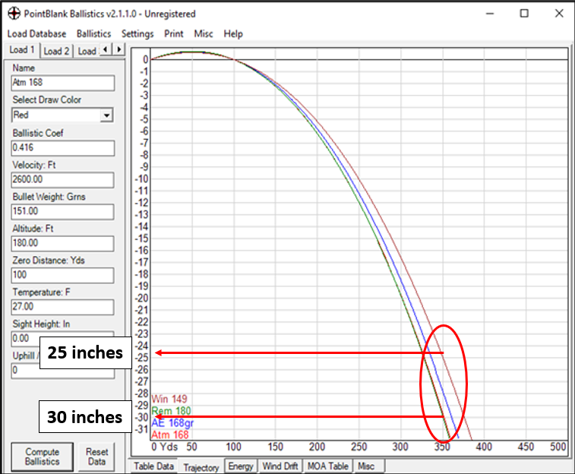
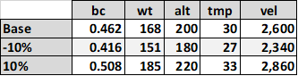
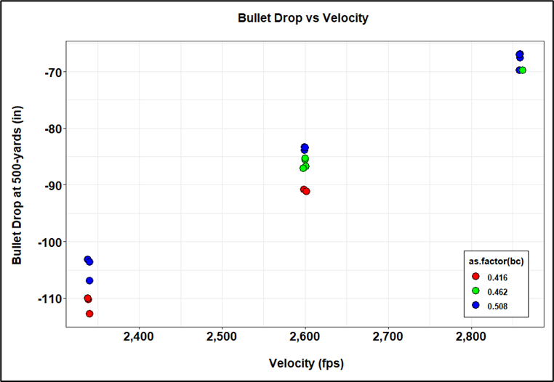
Does Velocity Matter
Point Blank Ballistics Software (www.huntingnut.com/pointblank.html)
Use Atomic 168gr ammunition test case in software for bullet drop at 500 yards

Slide 5
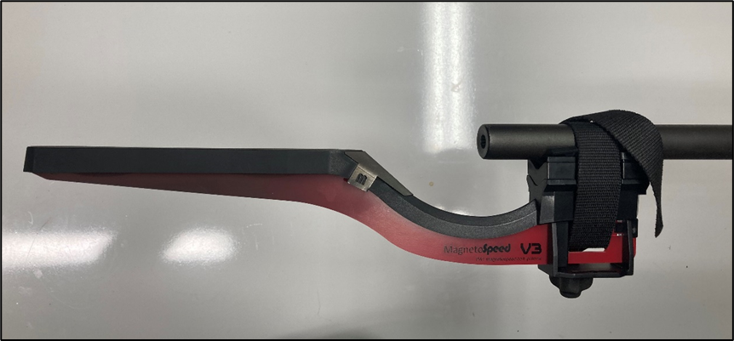
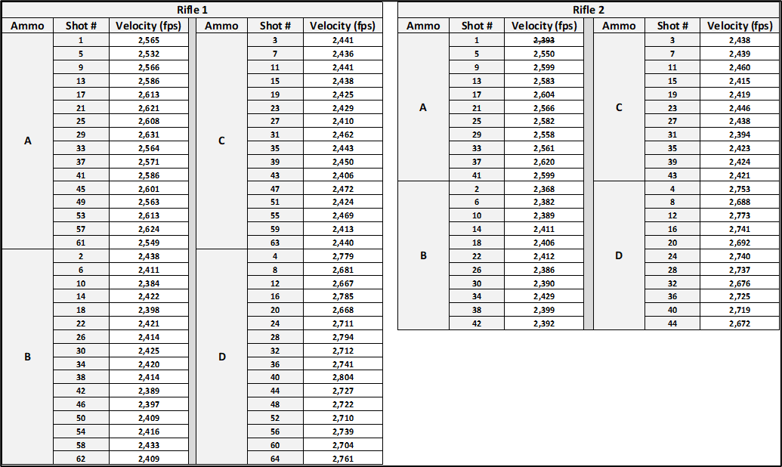
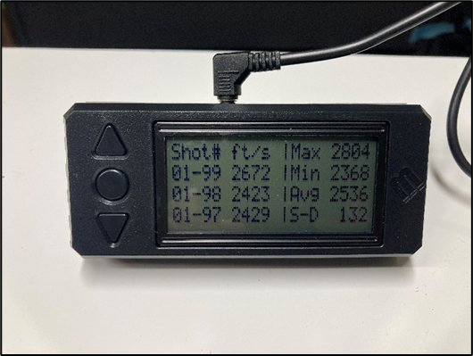
Gathering Data
MagnetoSpeed V3 Ballistic Chronograph
Recorded Factors
Ammunition
Shot Count
Rifle
Digital Display Box

Slide 6
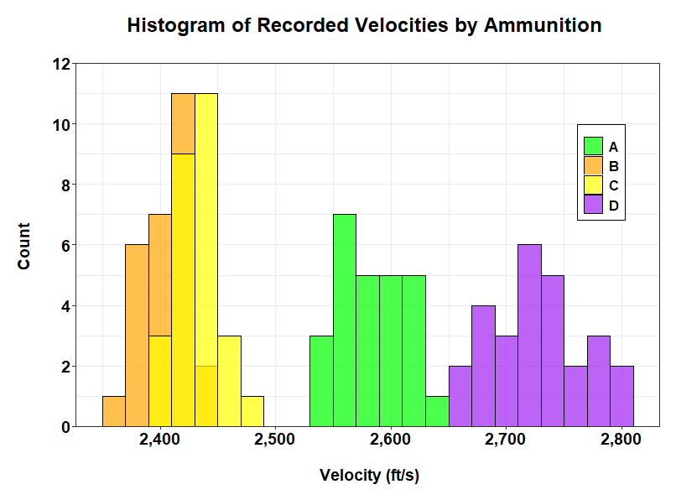
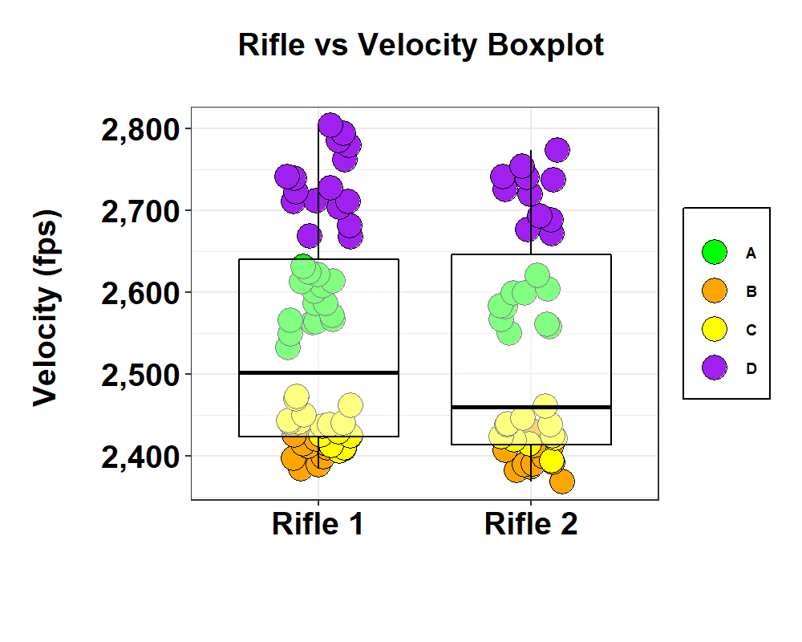
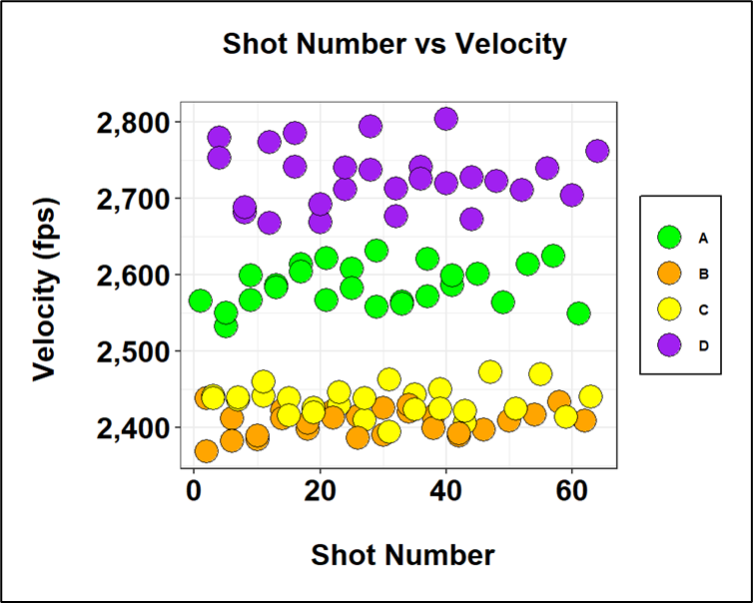
Sifting Through

Slide 7
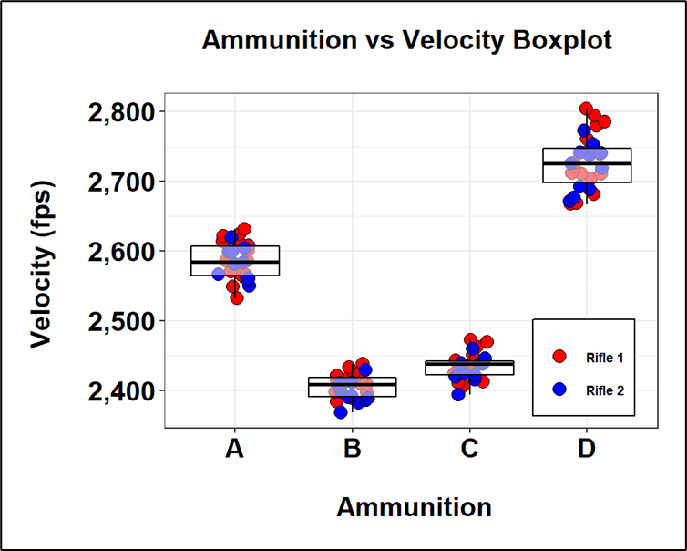
Sifting Through

Slide 8
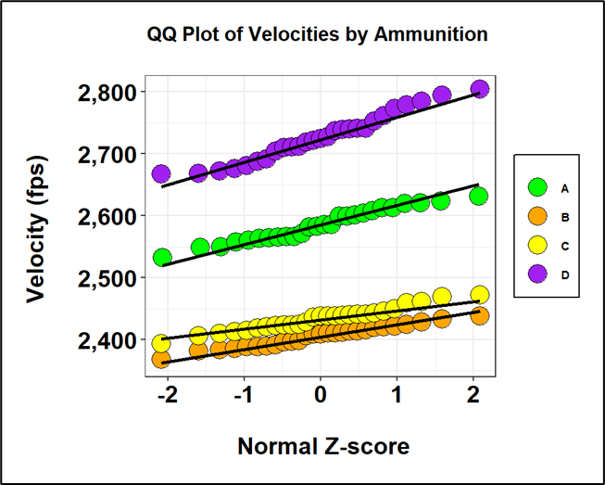
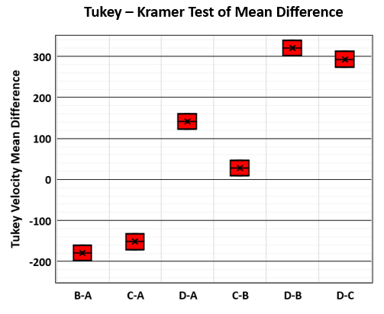
Finding Minimum Variance
Does the ammunition behave normally?
Is there a difference between ammunitions?

Slide 9
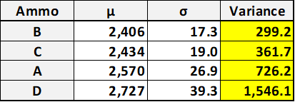
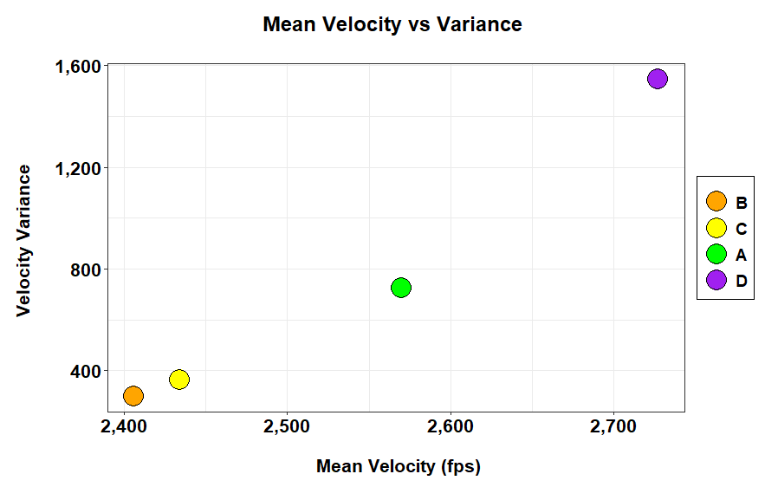
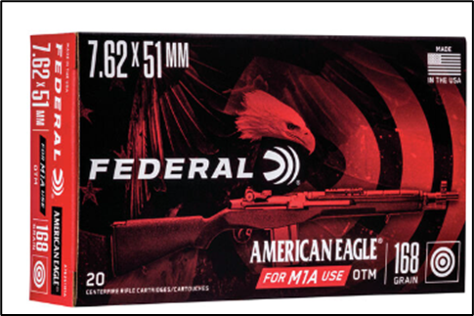
Finding Minimum Variance
Request: Which ammunition has the smallest variance in velocity?
B: AMERICAN EAGLE 168gr OTM

Slide 10
Questions?

